Slide 1
Medical Treatment Negligence Analysis
Abinash Satapathy 16BCE0081
Achintya S Rao 16BCI0158
Arunim Roy 16BCE0447

Slide 2
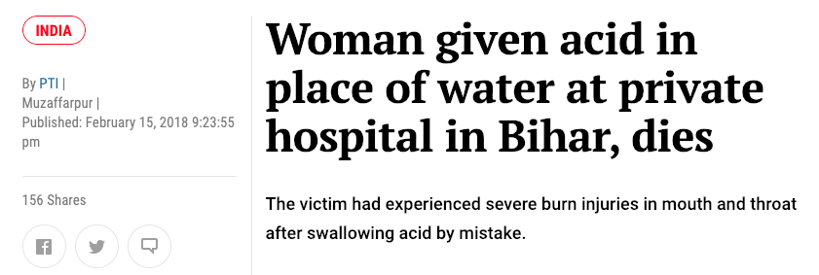
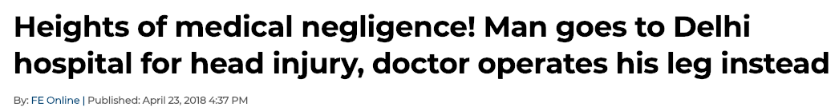
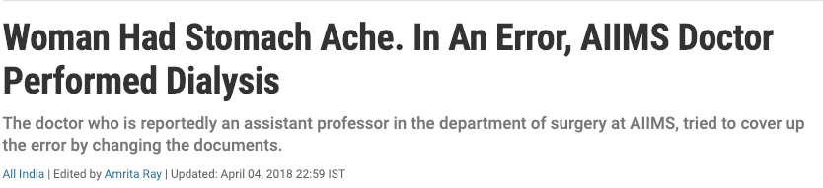

Slide 3
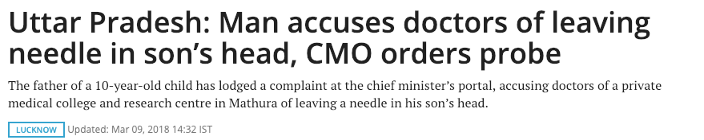
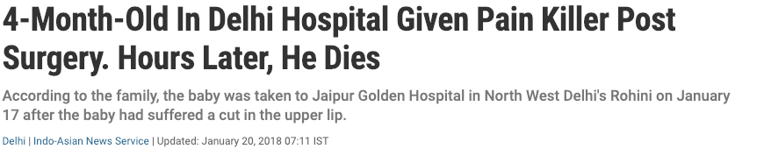
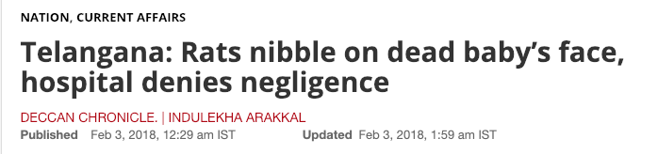

Slide 4
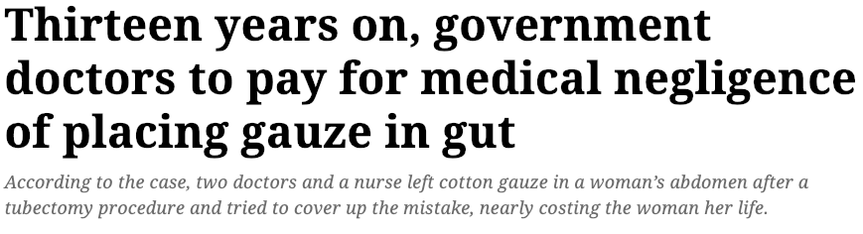

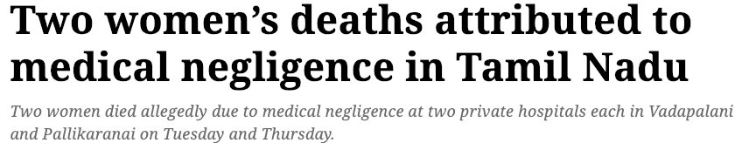

Slide 5
Objectives
To analyse cases related to medical treatment negligence
To develop a cognitive model to formulate the reasons and motives of such activities
To observe a pattern/trend in the issue
To prevent future occurrences of such mishaps by proposing the successful model on a larger scale

Slide 6
Idea
Our project aims to develop a cognitive model for analysis of the issues where negligence of doctors and hospitals has caused great distress to the affected families and people
Our idea is to extract insights from the collected news reports of various cases related to negligence of doctors/hospital authorities and classify the causes into different categories.

Slide 7
Social
Healthcare
Notes:
Reasons to be of Healthcare domain:
Involves doctors and patients
Involves hospital facilities
Involves surgery reports and medical practices
Sometimes involves euthanasia without consent
Reasons to be of Social domain:
Involves the public
Involves the issue of deaths of innocent people
Causes uproar among the general public
Affects individual or a certain community as whole

Slide 8
Methodology
Collection of news
Thorough study of the news
Getting relevant keywords to build the model
Building the cognitive model
Gathering inferences
Conclusion

Slide 9
Fuzzy Cognitive Maps will be used for modelling of the samples.
Poor
Rich
Bribery
Vengeance
Others
o
C1
C2
C3

Slide 10
Overall layout of the Fuzzy Cognitive Map with the circles representing various key terms obtained from the unstructured sample data, i.e. from the newspaper cuttings and online news.
Here, the weights will be decided later based on the interdependency of the terms with each other.

Slide 11
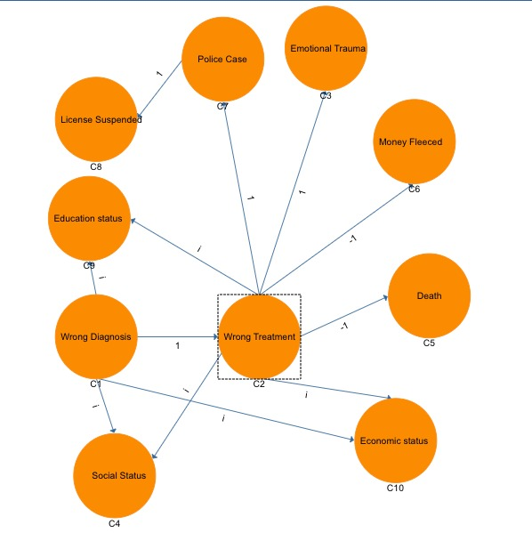

Slide 12
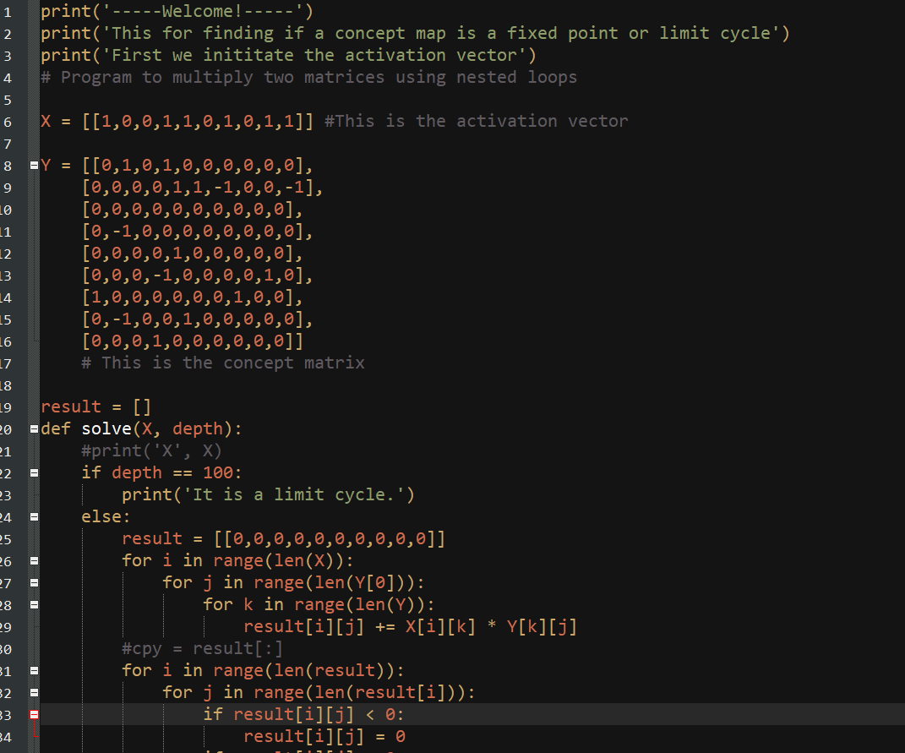

Slide 13
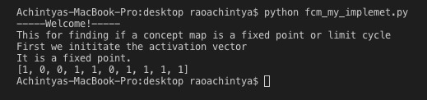

Slide 14
Conclusion
We inferred that medical negligence is not only caused due to the negligence of the doctors; rather it involves several other parameters like education status, bribery, hate, etc.
Hospital authorities should improve the environment conditions of the patients. It is one of the major causes of mishaps pertaining to patients.
Strong correlation exists between economy status and the mishaps happening due to negligence.

Slide 15
Thank you.

